Slide 1

HEALTHCARE DASHBOARD
USING POWER BI
By Mrunalini Yeole

Slide 2
INTRODUCTION
1
The Healthcare Dashboard on Power BI serves the crucial objectives of providing real-time insights and facilitating data-driven decision-making in healthcare. By visualizing patient demographics, clinical outcomes, resource allocation, and financial performance, it aims to help healthcare organizations monitor patient health, optimize operational efficiency, and improve overall healthcare delivery. Through intuitive visualization and interactive features, stakeholders can track key performance indicators, identify areas for improvement, and make informed decisions to enhance patient care and organizational effectiveness. Ultimately, the dashboard's objective is to empower healthcare providers, administrators, and policymakers with the tools they need to drive positive outcomes and elevate the quality of healthcare services.

Slide 3
2
DATASET
Here we have used two datasets for the creation of the dashboard
Inpatient
Outpatient
The Inpatient and Outpatient datasets consists of data of the patient from 2018 to 2021. They consists of attributes like archive date, speciality name, case type, age, time brands and many more.

Slide 4
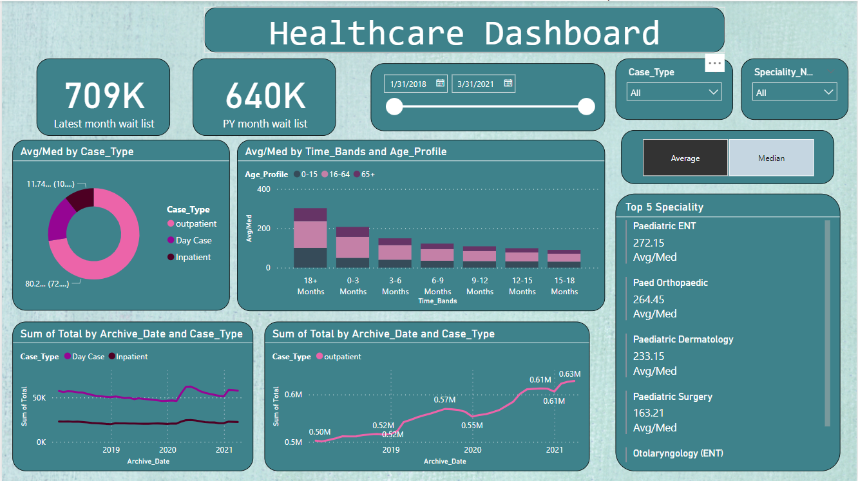
DASHBOARD
3

Slide 5
4
Applications
Clinical Decision Support: Healthcare professionals can utilize dashboards to access real-time patient data, such as vital signs, lab results, and medical histories, aiding in clinical decision-making and treatment planning.
Performance Monitoring: Healthcare administrators use dashboards to monitor hospital or clinic performance metrics, such as patient satisfaction scores, length of stay, and readmission rates, allowing for continuous improvement in service quality and efficiency.
Resource Allocation: Dashboards help healthcare organizations optimize resource allocation by providing insights into staff utilization, equipment availability, and patient flow, ensuring that resources are allocated effectively to meet patient needs.
Population Health Management: Healthcare providers can use dashboards to track population health trends, identify at-risk patient populations, and implement targeted interventions to improve health outcomes and reduce healthcare costs.
Financial Management: Healthcare dashboards enable financial managers to track revenue, expenses, and reimbursement rates, allowing for better financial planning and budget management to ensure the financial sustainability of healthcare organizations.

Slide 6
5
Conclusion
Healthcare dashboards represent a pivotal tool in modern healthcare management, facilitating informed decision-making, optimizing resource utilization, and ultimately improving patient outcomes. By providing real-time access to critical data metrics across various domains, from clinical performance to financial management, these dashboards empower healthcare professionals and administrators to navigate complex challenges effectively. With their ability to visualize trends, monitor performance, and ensure compliance, healthcare dashboards serve as indispensable assets in promoting efficiency, transparency, and quality across the healthcare ecosystem. As the healthcare landscape continues to evolve, the role of dashboards in driving innovation and enhancing patient-centered care remains paramount, underscoring their significance in shaping the future of healthcare delivery.

Slide 7
THANK YOU

